Slide 1


Capstone Project 1
Play store app review analysis
Done by:
Neha Jadhav
Akriti Panchbudhe
Akanksha Jadhav

Slide 2
Content
Project Description
Introduction
Data cleaning / null value implementation
Data processing
Data exploration
Basic observation
Insights from data
Conclusion
Challenges and future
Reference

Slide 3




WHY ANALYZE THE PLAY STORE?
Mobile App Market is set to grow 20% by 2023
Android apps comprise 75% of the Market Share. 85% sharein Brazil, India, Turkey
What are some interesting patterns in user behavior related to app usage & feedback
What makes an App popular? Can we predict how popular it’s going to be?

Slide 4
Project description:
The Playstore apps data has enormous potential to drive app-making businesses to success.
Actionable insights can be drawn for developers to work on and capture the Android market.
Each app(row) has values for category, ratings, size and more. Another dataset contains customer reviews of android apps.
As values for category ,ratings, size and more. Another dataset contains customer reviews of android apps.
Explore and analyze the data to discover key factors responsible for app engagement and success.

Slide 5
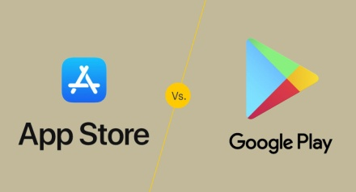
Introduction
Google Play was launched on March 6, 2012.
Google Play is an online store where people go to find their favorite apps, games, movies, TV shows, books, and more.
It provides 2 million apps & games to billions of people around the world, generating over $120 billion in earnings for developers to date.
The main objective of the Project is that to understand the Users demand what they expecting from using their apps and thus it helps to update and develop the product by Developers.
Google Play Store is found to be the largest app market in the world. It has been observed that although it generates more than double the downloads than the Apple App Store but makes only half the money compared to the App Store.

Slide 6
Problem statement
Two datasets are provided, one with basic information and the other with user reviews for the respective app.
We must examine and evaluate the data in both datasets in order to identify the important characteristics that influence app engagement and success.
For this project I analyze Play store data of 2017-2018 ,Google playstore is mostly use app store worldwide also top global market share.
My main objective is to find key factor responsible for app success
and engagement of users.
Thousands of new app regularly update playstore of different category.
I find distribution of every app based on their size, installs, reviews and much more.

Slide 7
Attributes in Google Playstore Data:
This contains data on the Google Play applications. It has 10,841 rows of data which has following columns.
App Category: Category of the app. This could be beauty, business, medical,art and design entertainment, education, family...etc.
Rating: It has How users rate the app out of 5, with 1 being the lowest rating and 5 being the highest.
Reviews: number of user reviews each app has received.
Size: The memory size needed to install the application.
Installs: The number of times each application has been installed by users.
Type: Whether the app is free or a paid app.
Price: The price of the app.
Content Rating: This column specifies the intended audience for the app. Can be for teens, mature audience, or everyone.
Genres: The sub-category for each app. Example: for the Education category, this could be Education: Pretend Play, for example.
Last Updated: Release date of the most recent update for the app.
Current Ver: The app's current version.
Android Ver: The oldest version of Android OS supported by the app.

Slide 8
Attributes in User Reviews:
Sentiment Analysis: This file contains the result of the sentiment analysis conducted by the dataset creator. It has 64,295 rows of data with the following columns:
App : Name of the app.
Translated_Review: Either the original review in English, or a translated version if the orignal review is in another language.
Sentiment: The result of the sentiment analysis conducted on a review. The value is either Positive, Neutral or Negative.
Sentiment_Polarity: A value indicating the positivity or negativity of the sentiment, values range from -1 (most negative) to 1 (most positive). Sentiment polarity for an element defines the orientation of the expressed sentiment, i.e. it determines if the text expresses the positive, negative or neutral sentiment of the user about the entity in consideration.
Sentiment_Subjectivity: A value from 0 to 1 indicating the subjectivity of the review. Lower values indicate the review is based on factual information, and higher values indicate the review is based on personal or public opinions or judgements.

Slide 9

Data Cleaning
Google Play store dataset has 10,841 observation of data with fields.
User reviews dataset has 64295 observation of data with fields.
Two data set -1) play store data 2) user reviews
List of fields:
App
Category
Rating
Reviews
Size
Installs
Type
Price
Content rating
Genres
Last updated
Current version
Android version
App
Translated review
Sentiment
Sentiment polarity
Sentiment subjectivity
Playstore data
User reviews

Slide 10
Data cleaning (Contd..)
Understand the structure of the dataset and clean data before analysis
Finding Missing value in dataset.
Correct data type(INT, FLOAT, DATE).
Replace null value with aggregate function (mean, mode,median).
Checking outliers.

Slide 11
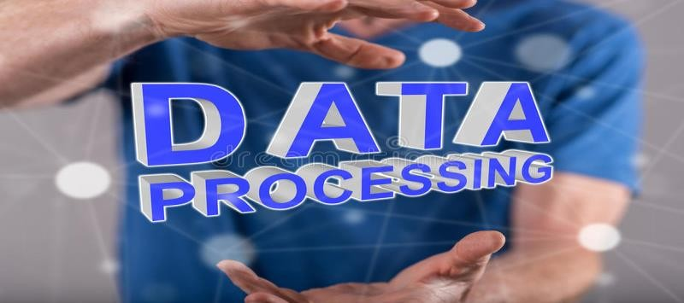
Data Processing
The dataset collected from the Play store is semi structured or unstructured and contains significant superfluous data (defined as not contributing significant meaning).Some data type needs to change in required format as int, float, date.
Sizing of apps needs to convert in one measurement KB or MB. Pre-processing includes various tasks including stemming, lowercase conversion, Units, punctuation, and excluding terms.

Slide 12

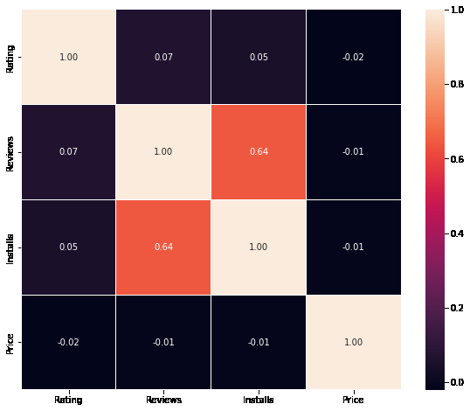
✭ Data Exploration
Correlation Heatmap
Clearly, we saw that reviews and installs are more correlated and the value is 0.64. It is much more obvious that a higher number of installs has a higher number of reviews. There is a negative correlation between price and install apps, with the price of the app influencing the number of installation of the app

Slide 13
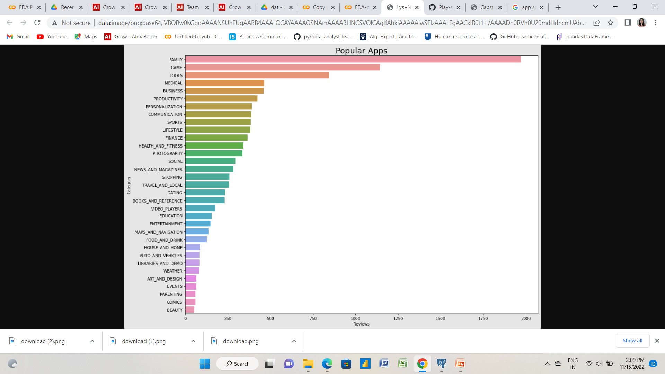
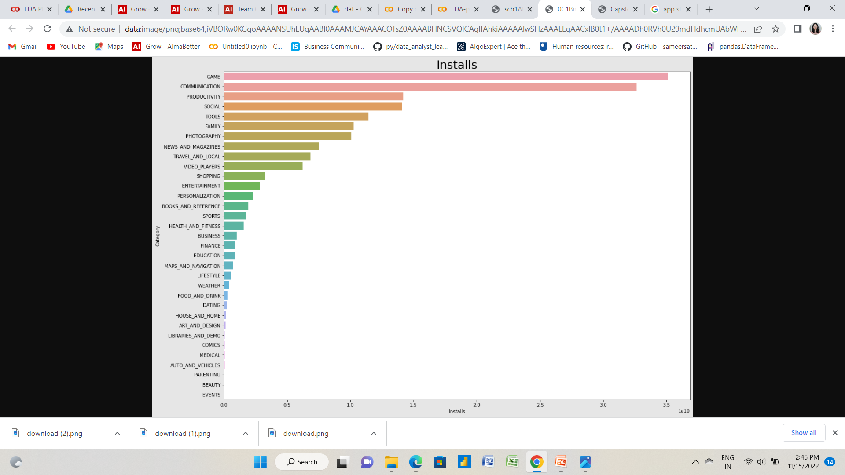
Most popular Apps
Most installed Apps
.
We can see that there are total 33 different categories in the dataset. The most popular apps are from 'Family' and 'Games' category. The least reviews are for the apps from 'Beauty' and 'Comics' Category.
we can see that most of the apps has been installed from 'Game' and 'Communication' category.
Let's see which apps are most installed Category wise.

Slide 14

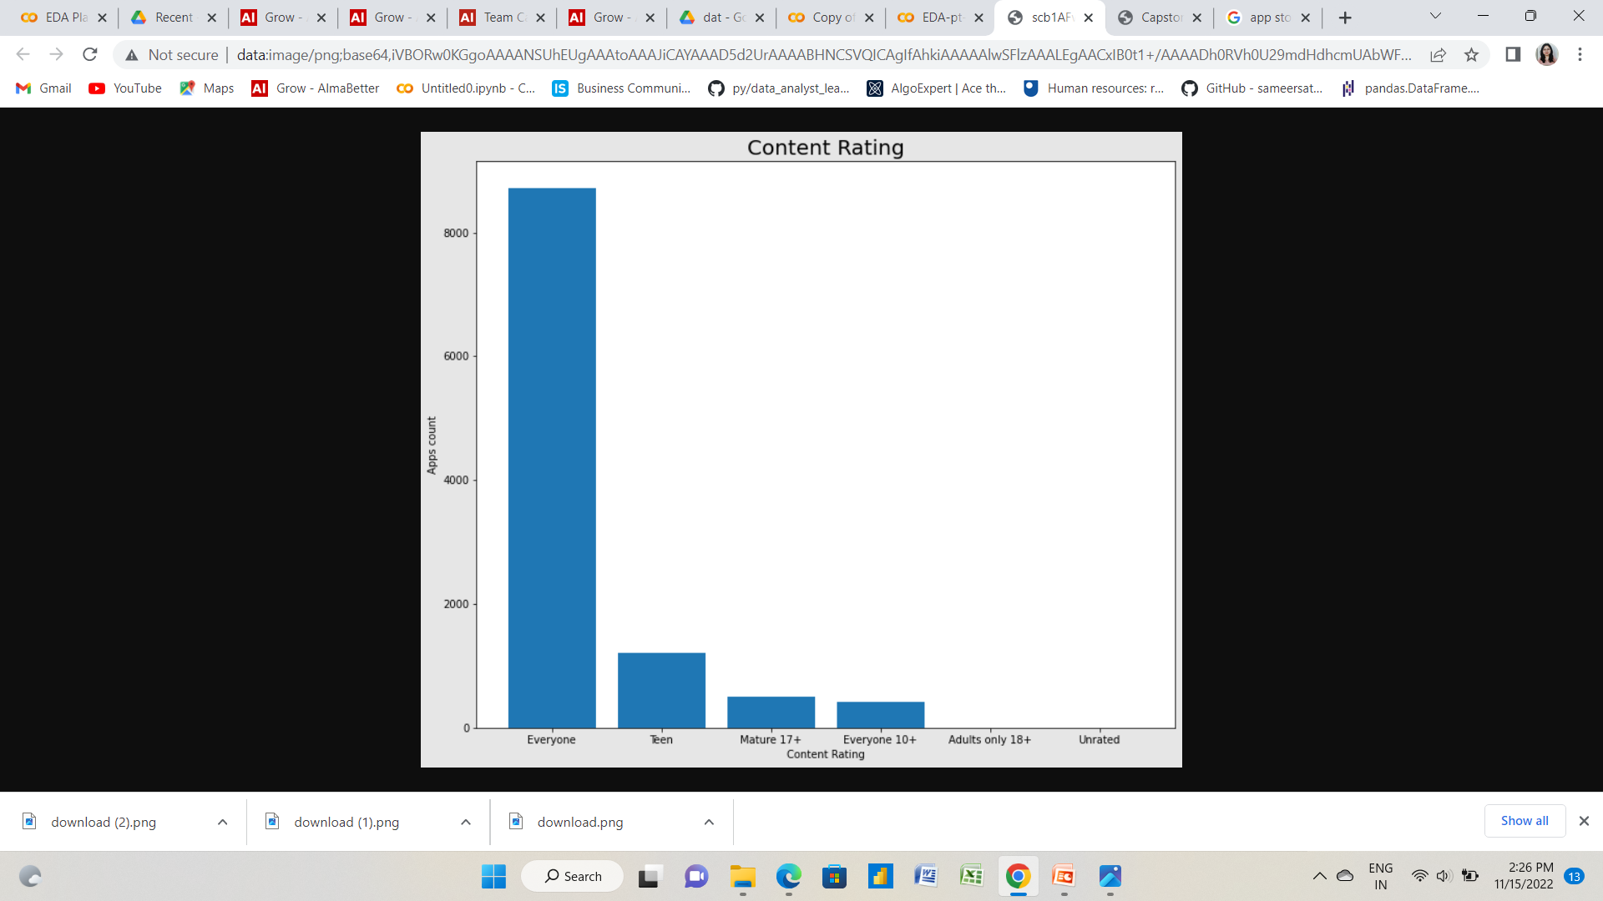
Content Rating of app
We can see that most of the content ratings are from 'Everyone' Category

